Slide 1
Pervasive Encryption for the Digital Enterprise
IBM z14 Education

Slide 2
Agenda
Pervasive Encryption Technical Foundation
z14 Hardware Encryption Overview
Pervasive Encryption Considerations
Next Steps
Resources

Slide 3
Pervasive Encryption with IBM z Systems
Technical Foundation
z14 -- Designed for Pervasive Encryption
CPACF – Dramatic advance in bulk symmetric encryption performance
Crypto Express6s – Doubling of asymmetric encryption performance for TLS handshakes
CFCC – Designed for CF data encryption (wrapped encryption key stored for recovery scenarios)
EKMF - Enterprise Key Management Foundation workstation as a new z Systems hardware feature
z/OS -- New approach to encryption in-flight and at-rest data
z/OS data set encryption – Transparent encryption of data at-rest
z/OS CF encryption –Transparent end-to-end encryption of CF data
z/OS Communication Server - Intelligent Network Security discovery & reporting
Linux on z/LinuxONE -- Full Power of Linux Ecosystem combined with z14 Capabilities
LUKS dm-crypt – Transparent file and volume encryption using industry unique CPACF protected-keys
Network Security – Enterprise scale encryption and handshakes using z14 CPACF and SIMD
Secure Service Container – Automatic protection of data and code for virtual appliance
zVM – Encrypted paging support
zTPF - Transparent database encryption (available 8/2016)
Software-only elements expected on previous generation of z Systems with differentiated value for z14
Notes:
CPACF Acceleration – Expecting 4-6x improvement for selected AES encryption modes:
Galois Counter Mode (GCM)
XEX-based tweaked-codebook mode with ciphertext stealing (XTS)
Cipher Block Chaining (CBC) – ~4x improvement decrypt only
GCM is a stream cipher and its use is defined as part of TLS specifications.
XTS is a block cipher mode typically used for disk encryption.
Programs making use of these encryption modes will realize the performance benefit when running on z14 hardware.
For SSL/TLS workloads it may be necessary to configure cipher suite to prefer GCM mode

Slide 4






Pervasive Encryption with IBM z Systems Enabled through full-stack platform integration
Integrated Crypto Hardware
Hardware accelerated encryption on every core – CPACF performance improvements of up to 7x
Next Gen Crypto Express6S – up to 2x faster than prior generation
Data at Rest
Broadly protect Linux® file systems and z/OS data sets¹ using policy controlled encryption that is transparent to applications and databases
Clustering
Protect z/OS Coupling Facility² data end-to-end, using encryption that’s transparent to applications
Network
Protect network traffic using standards based encryption from end to end, including encryption readiness technology² to ensure that z/OS systems meet approved encryption criteria
Secure Service Container
Secure deployment of software appliances including tamper protection during installation and runtime, restricted administrator access, and encryption of data and code in-flight and at-rest
Key Management
The IBM Enterprise Key Management Foundation (EKMF) provides real-time, centralized secure management of keys and certificates with a variety of cryptographic devices and key stores.
Statement of Direction* in the z/OS Announcement Letter (10/4/2016) - http://ibm.co/2ldwKoC
IBM z/OS Version 2 Release 3 Preview Announcement Letter (2/21/2017) - http://ibm.co/2l43ctN
And we’re just getting started …

Slide 5
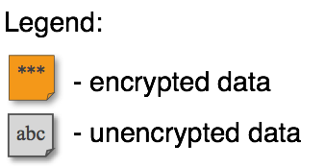


Data Protection // z/OS Dataset Encryption
z/OS 2.2 & 2.3
Protection of data at-rest
z/OS
DB2,IMS, zFS, etc...
abc
CPACF
Storage System
CF
***
SAN
***
Network
z/OS
z/OS
Client Value Proposition:
Reduced cost of encryption along with simple policy controls allows clients to enable extensive encryption to protect data in mission critical databases including DB2, IMS and VSAM
z/OS Dataset Encryption:
Application transparent & enabled by policy
Encryption tied to fine grained access control
Host encryption via CPACF as data written-to or read-from disk.
Supports ext. format sequential & VSAM
Includes HSM & DSS migration/backup of encrypted data sets
Supports: CICS, DB2, IMS, Logger, & zFS
In-memory system or application data buffers will not be encrypted
LinuxONE/Linux on z
Notes:
Text from IBM z/OS Version 2 Release 2 enhancements and statements of direction
(IBM United States Software Announcement 216-392, dated October 4, 2016)
IBM plans to deliver application transparent, policy-controlled dataset encryption in IBM zTM/OS. IBM DB2 for z/OS and IBM Information Management System (IMS) intend to exploit z/OS dataset encryption.
As indicated above, IBM plans to support z/OS data set encryption for DB2, IMS and CICS (e.g. CICS VSAM) data, as well as sequential data (BSAM, QSAM) for batch workloads (see page 30 & 31 for more details).
Data sets must be extended format BSAM, QSAM or VSAM.

Slide 6

Data Protection // Coupling Facility Encryption
z/OS 2.3
Protection of data in-flight and in-use (CF)
z/OS
abc
XES
Storage System
CPACF
CPACF
CF
***
Network
SAN
***
CF
Client Value Proposition:
Simplify and reduce cost of compliance by removing CF and CF data from compliance scope (i.e. ability to encrypt all CF data)
CPACF
CPACF
End-to-End encryption of CF Data:
Host Protected key CPACF Encryption (High Performance / Low Latency)
Data encrypted in the host and remains encrypted until decrypted by host
No application enablement required
List & Cache Structures only – No Lock!
z/OS
z/OS
z/OS Parallel Sysplex Cluster

Slide 7
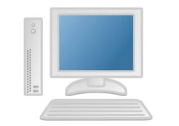
Data Protection // z/OS Network Security
z/OS 2.3
Protection of data in-flight
***
App A
abc
App B
COMM SERVER
abc
COMM SERVER
Storage System
***
CF
Network
SAN
Client Value Proposition:
Not all organizations use host-based network encryption today. Reduced cost of encryption enables broad use of network encryption and enhanced audit simplifies compliance.
z/OS
z/OS
Communication Server z Encryption Readiness Technology (zERT):
A z/OS administrator can determine when network traffic meets specified policy with new discovery and reporting capabilities
Currently no single method to easily determine which application traffic patterns are protected
LinuxONE/Linux on z

Slide 8
Data Protection // Linux on z File Encryption
Protection of data at-rest
Client Value Proposition:
Integration of hardware accelerated Crypto into standard components for wide reach into solutions
z/OS
z/OS
Storage System
CF
Network
SAN
***
z/OS
z/OS
Linux on z and LinuxONE
Focus on Transparent Enablement:
Transparent data encryption optimized with z14 CPACF hardware performance gains
Leverage industry-unique CPACF encryption which prevents raw key material from being visible to OS and applications.
***
LinuxONE/Linux on z
DB server
block device encryption
abc
CPACF
Status: dm-crypt enhancements for CPACF protected-key submitted upstream

Slide 9
Data Protection // Linux on z Network Security
Protection of data in-flight
z/OS
z/OS
Storage System
***
Network
CF
SAN
z/OS
z/OS
Client Value Proposition:
Not organizations use host-based network encryption today… reduced cost of encryption enables broad use of network encryption
Linux on z and LinuxONE
Focus on Transparent Enablement:
Transparently accelerate TLS & IPSec using CPACF & SIMD to leverage hardware performance gains
LinuxONE/Linux on z
Open SSL, Java, or GSKIT
App
***
CPACF
abc
Status: dm-crypt enhancements for CPACF protected-key submitted upstream

Slide 10
Data Protection // Secure Service Container
Extending the value of z hardware crypto
z/OS
z/OS
Storage System
Client Value Proposition:
Simplified, fast deployment and management of packaged solutions
Tamper protection during Appliance installation and runtime
Confidentiality of data and code running within the Appliance both at flight and at rest
Restricts administrator access to workload and data
Secure Service Container architecture builds on the value z systems hardware crypto using a runtime environment designed to help clients reduce risk.
Network
CF
SAN
LinuxONE / z Systems
z/OS
z/OS
LinuxONE/ z Systems
Secure Service Container
Protected-key CPACF – key value not visible to OS or application

Slide 11
Data Protection // z/VM Encrypted Paging
z/VM 6.4
***
***
z/VM
z/VM
xyz
CPACF
def
CPACF
SSI
Encrypted Paging
Threat: access to sensitive data when stored on CP owned disk
Solution: encrypt guest data on page-out.
Notes:
Paging is not SSI-relevant
Paging data does not need to survive an IPL
Ephemeral CPACF protected-key stored in CP (not on disk somewhere)
AES encryption
Very low overhead via CPACF
z/VM
z/VM
abc
CPACF
***
z/VM Single System Image cluster
Client Value Proposition:
Protect guest paging data from administrators and/or users with access to volumes

Slide 12
Data Protection // z/TPF Transparent Database Encryption
z/TPF 1.1.0.13
Technical Foundation
z/TPF at-rest Data Encryption
Automatic encryption of at-rest data
No application changes required
Database level encryption using highly efficient CPACF HW crypto
Includes data on disk and cached in memory
Optionally can include data integrity checking to detect accidental or malicious data corruption
Additional Information
Data encrypted using AES CBC (128 or 256)
Optional integrity checking uses SHA-256
Includes tools to migrate an existing DB from unencrypted to encrypted state or change the encryption key/algorithm for a given DB while transactions are flowing (no DB downtime)
Support shipped August 2016
(APAR PI56476)
Client Value Proposition:
Transparent encryption of TPF database data plus reduced cost of encryption allows clients to enable extensive encryption of TPF data.

Slide 13
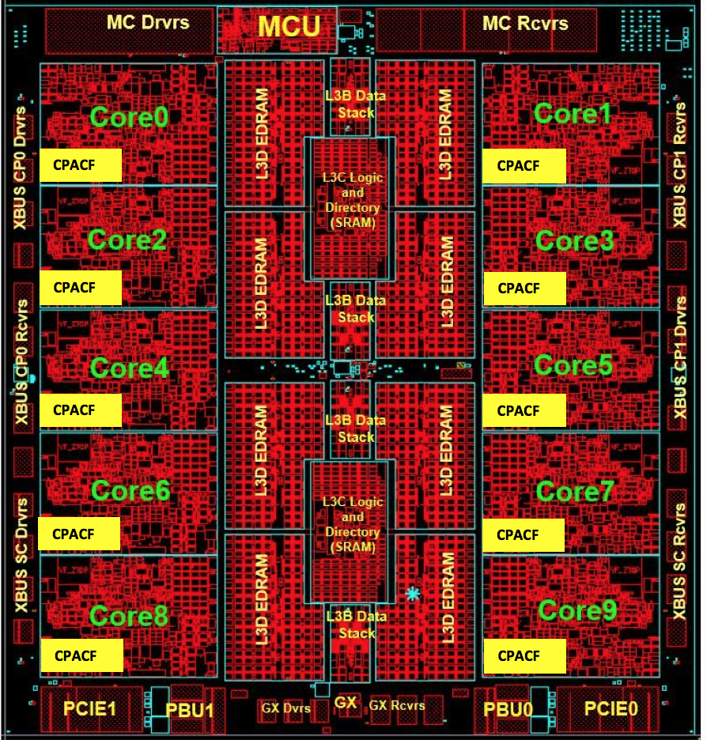
z14 CPACF - Dramatic advance in bulk encryption performance
Reduced overhead on short data (hashing and encryption)
4-6x improvement for select AES encryption modes
GCM – encryption of data in-flight (e.g. TLS, IPsec)
XTS – LoZ file and data set encryption
CBC decrypt – CF data encryption, Guardium, z/TPF
~ 2x improvement for other encryption modes
--------------------------------------------------------------------------------------
MSA-6: SHA3 hashing algorithm
KIMD-SHA3, KLMD-SHA3, KIMD-SHAKE, KLMD-SHAK3
MSA-7: True Random Number Generator for fast generation of session keys
PRNO-TRNG
MSA-8: Authenticated encryption (e.g. AES-GCM) using single instruction combining encryption and hashing
KMGCM

Slide 14
z14 CPACF - Performance Measurement Considerations
CPACF on chip encryption/decryption support has been greatly optimized on the z14 machine.
Early primitive testing validates up to 6X faster
Performance benefits for z14 are better when working with large blocks of data.
Data set encryption will benefit from large block sizes
Encryption overhead is expected to be low for most OLTP workloads.
I/O generally avoided where possible (buffer pools, caching)
Encryption overhead very small relative to the total workload CPU
Encryption cost will be higher for extremely I/O Intensive workloads
Lots of I/O (lots of data to encrypt/decrypt)
Encryption overhead higher relative to total workload CPU

Slide 15
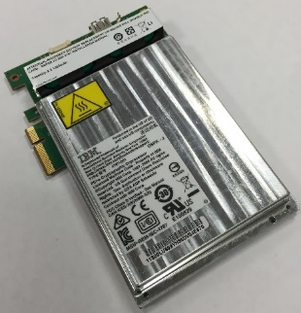
z14 Crypto Express6S Cryptographic Coprocessor
General Availability in z14
Available as machine type model 4768 beyond 2017
Enhanced Card Performance :
Main PPC 476 (Qty 2 in lock-step) @ 1.2Ghz
PCI Express Gen 2
DDR3 1600
Persistent Memory Management for faster boot time (FPGA)
New Miniboot Implementation for certification compliance
Allows easier transition of algorithms when certification requirements change
Upgraded secure module tamper detection technology :
Improved thermal capabilities for increased performance
Continued support for temperature and voltage detection
Enhanced Public Key Cryptography Algorithms performance (2x)

Slide 16




z14 Crypto Express6S - Security Certifications
Physical Security Standards in Progress/planned:
FIPS 140-2 level 4
Common Criteria EP11 EAL4
Payment Card Industry (PCI) HSM
German Banking Industry Commission (GBIC, formerly DK)
French MEPS (French GIE CB)
CCA 6.0 - Main focus PCI-HSM enforcement
Secure version reporting
Domain scope compliance configuration: 1 domain = normal OR normal+compliant
GA1 / GA2: multi-stage support rollout (TDES first)
Compliance-tagged (“comp-tag”) key support in 2nd key hierarchy:

Slide 17
TKE 9.0 at a Glance
Hardware
Ships with z14
TKE 9.0 LIC requires the new 4768 crypto adapter
TKE 9.0 required to manage Crypto Express6 on z14
MES
TKE 8.0 & 7.3 (feature 0842 only) workstations can be upgraded to TKE 9.0 with purchase of a 4768
Omnikey Cardman 3821 smart card readers can be carried forward to any TKE 9.0 workstation¹
Previously initialized and personalized smart cards can be carried forward and used on any TKE 9.0 workstation¹
New TKE 9.0 Purchase:
TKE 9.0 tower workstation: feature code 0086
TKE 9.0 rack-mounted workstation: feature code 0085
New Smart Card Readers, Gemalto CT700, ship with TKE 9.0
Feature Overview
Usability
Zone to zone copy of key parts
Save/Restore data using TKE directory structure
Ability to generate key parts without opening host
Reduce number of commands for domain group load, set, or clear (CCA 5.3 or later)
Audit
TKE Audit Log browse application
TKE heartbeat audit record for periodic status monitoring
PCI HSM
Management PCI HSM settings and migration for CEX6S/CCA 6.0
¹ - Gemalto CT700 readers will only work with smart cards that have applets loaded from TKE 8.1 or later. Therefore, must carry Omnikey Cardman 3821 smart card readers forward to use smart cards with pre-TKE 8.1 applets on TKE 9.0

Slide 18
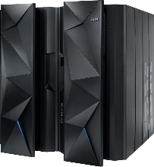
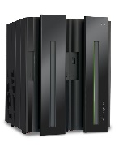
EKMF Hardware & Software Delivery Proposal
Deliver EKMF Workstation + Crypto adapter → New z Systems z14 feature
Similar to the Trusted Key Entry Workstation of today
Feature Codes for Rack and Tower configurations
Crypto Coprocessor pre-installed
Covered by the same service & support as the CEC for HW issues
No workstation code installed as part of the EKMF feature
Deliver EKMF software -> Software PID
Incudes both workstation and z Systems host components
During the install & config process, the .iso image is downloaded from z/OS to a workstation and burned to the optical install media (DVD) is created
Installer boots the DVD – installer auto installs the OS, EKMF Application, plus Crypto Express firmware
Separating the workstation software from the hardware will help position the workstation software to allow more frequent updates than is typically done with firmware

Slide 19
zSecure 2.3 Pervasive Encryption Support
Command Verifier: Command Verifier policy for DATAKEY
Admin: Easy administration DATAKEY on DFP segment
Audit: Report on non-VSAM and VSAM data sets key labels
Extend existing report types DSN / SENSDSN
Audit: Report key protection CSFKEYS
New report types ICSF_SYMKEY, ICSF_PUBKEY
Audit: Report which systems sharing DASD can decrypt ds
Audit: Extend report type SMF
Type 14/15 non-VSAM and Type 62 VSAM keylabel use
ICSF
zERT records to show encryption strengths
Planned GA Q3 2017

Slide 20
Considerations
Understanding Positioning with other encryption solutions
Estimating CPU Cost of Encryption
Compression & Encryption
Setting up z/OS data set encryption – high level steps
Naming Conventions
Key Management
Software Rollout

Slide 21
Multiple Layers of Encryption Robust data protection
z14 CPACF Performance enables encryption at course scale
App Encryption hyper-sensitive data
Database Encryption Provide protection for very sensitive in-use (DB level), in-flight & at-rest data
Full Disk and Tape Encryption Provide 100% coverage for in-flight & at-rest data with zero host CPU cost
File or Dataset Level Encryption Provide broad coverage for sensitive data using encryption tied to access control for in-flight & at-rest data protection
Data protection & privacy provided and managed by the application… encryption of sensitive data when lower levels of encryption not available or suitable
Granular protection & privacy managed by database… selective encryption & granular key management control of sensitive data
Complexity & Security Control
Broad protection & privacy managed by OS… ability to eliminate storage admins from compliance scope
Protection against intrusion, tamper or removal of physical infrastructure
Coverage

Slide 22
Data Protection // Existing Disk Encryption
Protection of data at-rest
z/OS
abc
abc
Storage System
CF
Network
SAN
***
z/OS
z/OS
***
DS8000 Disk Encryption
Encrypting disk drives protect data at rest when disk drives are retired, sent for repair or repurposed
Once the key has been served to storage system any system connecting to storage system can retrieve unencrypted data
LinuxONE/Linux on z
xyz
xyz

Slide 23
Multiple layers of encryption for data at-rest Robust data protection
App Encryption hyper-sensitive data
Database Encryption Provide protection for very sensitive in-use (DB level), in-flight & at-rest data
Full Disk & Tape Provide 100% coverage for in-flight & at-rest data with zero host CPU cost
File or Data Set Level Encryption Provide broad coverage for sensitive data using encryption tied to access control for in-flight & at-rest data protection
Data protection & privacy provided and managed by the application… encryption of sensitive data when lower levels of encryption not available or suitable
Full Disk & Tape Encryption
Protects at the DASD subsystem level
All or nothing encryption
Only data at rest is encrypted
Single encryption key for everything
No application overhead
Zero host CPU cost
Prevents exposures on: Disk removal, Box removal, File removal
Granular protection & privacy managed by database… selective encryption & granular key management control of sensitive data
Broad protection & privacy managed by OS… ability to eliminate storage admins from compliance scope
Full Disk and Tape Encryption Provide 100% coverage for in-flight & at-rest data with zero host CPU cost
Protection against intrusion, tamper or removal of physical infrastructure
Protection against intrusion, tamper or removal of physical infrastructure
Coverage

Slide 24
Multiple layers of encryption for data at-rest Robust data protection
App Encryption hyper-sensitive data
Database Encryption Provide protection for very sensitive in-use (DB level), in-flight & at-rest data
Full Disk & Tape Provide 100% coverage for in-flight & at-rest data with zero host CPU cost
File or Data Set Level Encryption Provide broad coverage for sensitive data using encryption tied to access control for in-flight & at-rest data protection
Data protection & privacy provided and managed by the application… encryption of sensitive data when lower levels of encryption not available or suitable
z/OS Data Set Encryption
Enabled by policy
Transparent to applications
Tied to access control
Uses protected encryption keys managed by the host
Granular protection & privacy managed by database… selective encryption & granular key management control of sensitive data
Complexity & Security Control
File or Data Set Level Encryption Provide broad coverage for sensitive data using encryption tied to access control for in-flight & at-rest data protection
Broad protection & privacy managed by OS… ability to eliminate storage admins from compliance scope
Broad protection & privacy managed by OS… ability to eliminate storage admins from compliance scope
Protection against intrusion, tamper or removal of physical infrastructure
Broadly encrypt data at rest
Covers VSAM, DB2, IMS, Middleware, Logs, Batch, & ISV solutions¹
Encrypt in bulk for low-overhead
Utilizes IBM z Systems integrated cryptographic hardware
Applications or middleware making use of VSAM, QSAM, BSAM access methods. Refer to individual ISV documentation to confirm support of z/OS data set encryption.
Coverage

Slide 25
Multiple layers of encryption for data at-rest Robust data protection
App Encryption hyper-sensitive data
Database Encryption Provide protection for very sensitive in-use (DB level), in-flight & at-rest data
Full Disk & Tape Provide 100% coverage for in-flight & at-rest data with zero host CPU cost
File or Dataset Level Encryption Provide broad coverage for sensitive data using encryption tied to access control for in-flight & at-rest data protection
Data protection & privacy provided and managed by the application… encryption of sensitive data when lower levels of encryption not available or suitable
IBM Security Guardium Data Encryption for DB2 and IMS Databases
Database Encryption Provide protection for very sensitive in- use (DB level), in-flight & at-rest data
Granular protection & privacy managed by database… selective encryption & granular key management control of sensitive data
Broad protection & privacy managed by OS… ability to eliminate storage admins from compliance scope
Encrypts sensitive data at the DB2 row and column levels and IMS segment level
Transparent to applications
Separation of Duties (SOD) and granular access control
Protects Data-In-Use within memory buffers
Clear text data cannot be accessed outside DBMS access methods
Persists the encrypted sensitive data in logs, image copy data sets, DASD volume backups
Utilizes IBM z Systems integrated cryptographic hardware
Protection against intrusion, tamper or removal of physical infrastructure
Coverage

Slide 26
Multiple layers of encryption for data at-rest Robust data protection
App Encryption hyper-sensitive data
App Encryption hyper-sensitive data
Database Encryption Provide protection for very sensitive in-use (DB level), in-flight & at-rest data
Full Disk & Tape Provide 100% coverage for in-flight & at-rest data with zero host CPU cost
File or Data Set Level Encryption Provide broad coverage for sensitive data using encryption tied to access control for in-flight & at-rest data protection
Data protection & privacy provided and managed by the application… encryption of sensitive data when lower levels of encryption not available or suitable
Data protection & privacy provided and managed by the application… encryption of sensitive data when lower levels of encryption not available or suitable
Application Encryption
Granular protection & privacy managed by database… selective encryption & granular key management control of sensitive data
Requires changes to applications to implement and maintain
Highly granular
Protect data right up to the point where it will be used
Applications must be responsible for key management
Appropriate for selective encryption of hyper-sensitive data
Broad protection & privacy managed by OS… ability to eliminate storage admins from compliance scope
Protection against intrusion, tamper or removal of physical infrastructure
Coverage

Slide 27
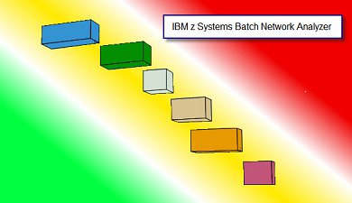
Estimating CPU Cost of Data Protection
z Batch Network Analyzer (zBNA)
Background:
A no charge, “as is” tool originally designed to analyze batch windows
PC based, and provides graphical and text reports
Available on techdocs for customers, business partners, and IBMers http://www-03.ibm.com/support/techdocs/atsmastr.nsf/WebIndex/PRS5132
Previously enhanced for zEDC to identify & evaluate compression candidates
Encryption Enhancements:
zBNA will be further enhanced to help clients estimate CPU overhead for enabling encryption based on client workload SMF data
Ability to select z13 or z14 as target machine
Support will be provided for
z/OS data set encryption
Coupling Facility encryption

Slide 28
Compression and Encryption
Encrypted data does not compress!
Any compression downstream from encryption will be ineffective
Where possible compress first, and then encrypt
z/OS data set encryption
DFSMS will compress first (generic, tailored, enhanced, and zEDC) then encrypt
Data sets will remain encrypted during HSM and DSS migration and backup processing
Data sets will remain encrypted during hardware based data replication services
zEDC is expected to significantly reduce the CPU cost of encryption
Great compression ratios (5X or more for most files)
Less data to encrypt means lower encryption costs
Compressed data sets use large block size for IO (57K)
Applicable to QSAM, and BSAM access methods
+

Slide 29
z/OS data set encryption – High Level Steps
1
2
3
4
Generate an encryption key and key label, store it in the CKDS .
Setup for use of key label in RACF.
Associate the key label with the desired data set(s).
Migrate to encrypted data
Allow secure key to be used as protected key
via ICSF segment
SYMCPACFWRAP
SYMCPACFRET
DB2:
Online Reorg
In RACF, alter DFP segment in data set profile - DATAKEY()
Non-disruptive
IMS HA Database:
Online Reorg
Non-disruptive
– OR –
– AND –
zFS Container:
zfsadmin encrypt
In DFSMS, assign to data class
Non-disruptive
Grant access to key label
VSAM or Seq data set:
Stop application
Copy data
Restart application

Slide 30
Naming Conventions & Granular Access Control
Leveraging naming conventions & z Security to enforce separation across application instances
Naming conventions can be used to segment applications, data, and keys, e.g.
Environment: PROD, QA, TEST, DEV
Application: App1, App2,…, AppN
Data-Type: Account, Payroll, Log
Recommend use of version # to support key rotation
Version: Ver1, Ver2,…,VerX
Application resources (data sets, encryption keys) can be assigned names based on naming conventions, e.g.
PROD.APP2.LOG.VER10
PROD.APP1.PAYROLL.KEY.VER7
Security rules can be used to enforce separation with granular access control for application resources and encryption keys
PROD
MK_{PROD}
App1
AppN
Data1
PROD.App1.Data1.VerX
DataN
PROD.AppN.DataN.VerX
Data2
App2
PROD.App2.Data2.VerX
PROD CKDS
PROD.App1.Data1.VerX PROD.App2.Data2.VerX PROD.AppN.DataN.VerX
***
***
***

Slide 31
Enterprise Key Management Considerations Encryption of data at enterprise scale requires robust key management
The current key management landscape can be characterized by clients who have …
… already deployed an enterprise key management solution
… developed a self-built key management solution
… not deployed an enterprise key management solution
Key management for pervasive encryption must provide …
Policy based key generation
Policy based key rotation
Key usage tracking
Key backup & recovery
The IBM Enterprise Key Management Foundation (EKMF) provides real-time, centralized secure management of keys and certificates in an enterprise with a variety of cryptographic devices and key stores.
EKMF

Slide 32
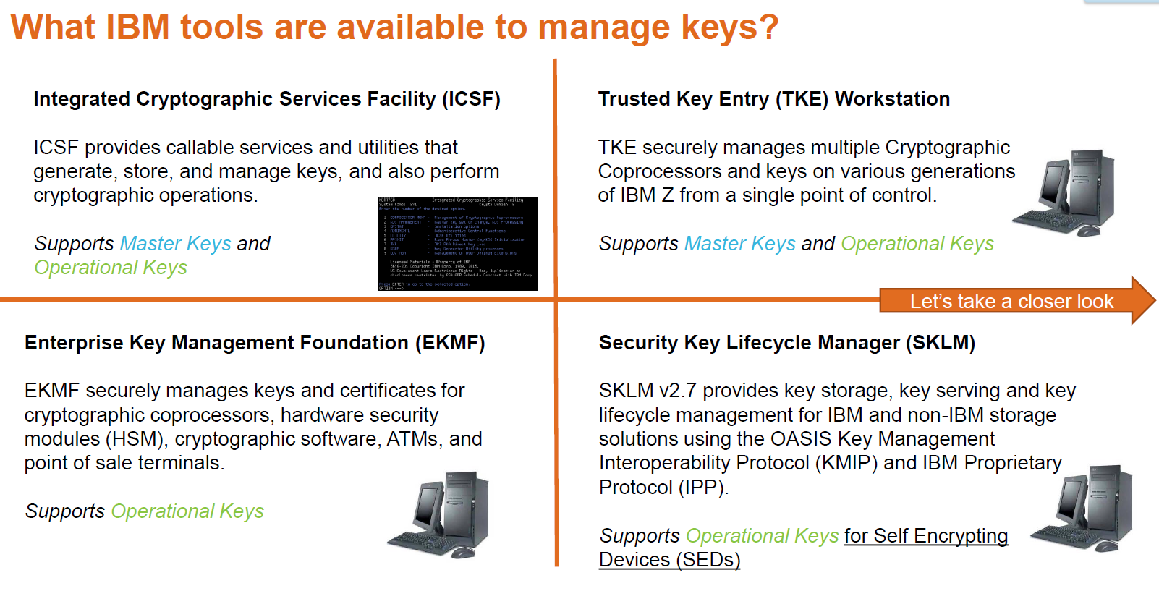


Current IBM Key Management Landscape…

Slide 33
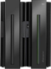
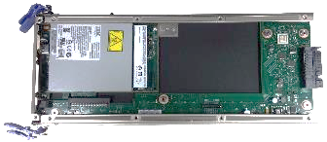
High Availability Key Management Considerations ICSF Parallel Sysplex Enablement
EP-11 MK
EP-11 MK
z/OS ICSF can provide a Single System Image view by allowing key stores to be shared by all members of the sysplex.
Enabled via SYSPLEXCKDS(YES), SYSPLEXPKDS, SYSPLEXTKDS
Wrapped keys cached in-memory for fast access.
Updates are automatically propagated across the sysplex (via signaling) to maintain cache coherency.
Key store management operations are coordinated across the sysplex
Same Master Key must be loaded into all HSMs
HSM
Master Key
HSM Master Key
EP-11 MK
EP-11 MK
HSM
Master Key
HSM Master Key
Shared ICSF Key Store
MK VP
DES
AES
RSA
ECC
Record
Label
Token

Slide 34
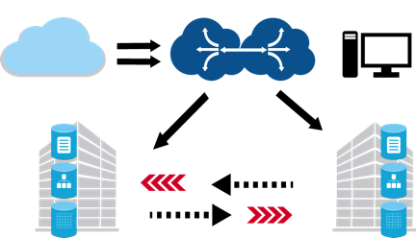

Disaster Recovery Key Management Considerations
Replication of Cryptographic Key Material for Multi-Site DR Solutions
Configure and maintain both sites to run the same cryptographic workload
Replicated copies of encrypted z/OS data sets will also be encrypted/protected.
Replicate cryptographic coprocessor configurations across both sites:
Master Keys, access control points, etc…
Done at initial setup & periodic MK change
Can be simplified with TKE domain groups
Replicate cryptographic key material across both sites:
Define ICSF Key Store datasets on replicated volumes
CKDS
PKDS
TKDS
CKDS
PKDS
TKDS
Supports Multi-site Disaster Recovery Solutions. e.g. GDPS PPRC, XRC, GM, MGM, etc...

Slide 35
Continuous Availability Key Management Considerations z Systems - Active/Active Sites – Proposed ICSF Support – Targeting 3Q/4Q
Application generates and writes new key material to the ICSF key stores
ICSF updates the in-storage key cache with the new key material
ICSF hardens the new key material to the KDS and issues a XCF signal to other ICSF instances in the sysplex to refresh the in-memory key cache
GDPS replicates the key record to the DR sysplex
The GDPS apply engine invokes a new ICSF which updates the in-storage key cache, writes the key record to the appropriate KDS
ICSF XCF signals other systems in the DR sysplex to refresh in-memory caches (7)
Production Sysplex
DR Sysplex
Application/workload
Application/workload
Application/workload
Application/workload
1
3
3
6
7
2
XCF
XCF
ICSF
ICSF
ICSF
ICSF
Key material available real time in both sites
5
3
CKDS
PKDS
TKDS
CKDS
PKDS
TKDS
VSAM
VSAM
4
GDPS Change Engine
GDPS Apply Engine
4
SW Replication

